Slide 1
Regression Models for Biostatistics 1 (RM1)
Prof. Armando Teixeira-Pinto

Slide 2
Learning outcomes
Use residuals to test simple linear regression assumptions
Recognise when transformations of the response and/or covariate may be needed and be familiar with common transformations
Derive the interpretation of regression coefficients after transformation
Describe the different motivations for regression modelling
Formulate a simple linear regression model
Understand the least squares method of parameter estimation and its equivalence to maximum likelihood
Interpret statistical output for a simple linear regression model
Calculate and interpret confidence intervals and prediction intervals for simple linear regressionUse residuals to test simple linear regression assumptions
Recognise when transformations of the response and/or covariate may be needed and be familiar with common transformations
Derive the interpretation of regression coefficients after transformation
Notes:
This week you will learn about how to
Use residuals to test simple linear regression assumptions
Recognise when transformations of the response and/or covariate may be needed and be familiar with common transformations
and
Derive the interpretation of regression coefficients after transformation

Slide 3
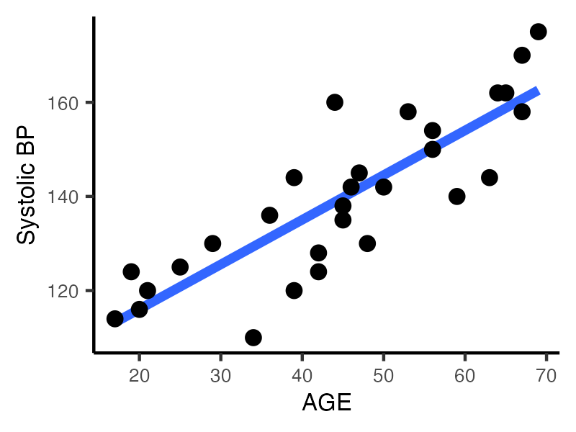

Slide 4
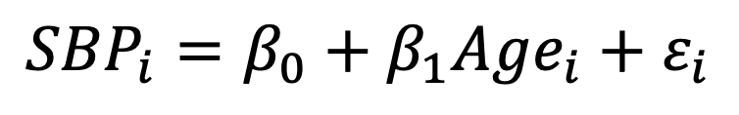
$${SBP}_{i}=β_{0}+β_{1}{Age}_{i}+ε_{i}$$

Slide 5
$${SBP}_{i}=β_{0}+β_{1}{Age}_{i}+ε_{i}$$

Slide 6

$${SBP}_{i}=β_{0}+β_{1}{Age}_{i}+ε_{i}$$
$$ε_{i}\underset{i.i.d}{∼}{N(0, σ_{ε}) }$$

Slide 7
Assumptions
$${SBP}_{i}=β_{0}+β_{1}{Age}_{i}+ε_{i}$$
$$ε_{i}\underset{i.i.d}{∼}{N(0, σ_{ε}) }$$
The relationship between the mean SBP and Age is linear
Observations are independent
SBP|Age is normal (residuals are normally distributed)
And the variance of the residuals is constant (homoscedasticity)
Notes:
The first of which is “simple linear regression”, where we have a continuous outcome, in this case systolic blood pressure, and a continuous covariate in this case age. As this relationship looks fairly linear, or straight, we can describe it with the equation of a line shown. The equation has two parameters beta 0 and beta 1. Beta 0 is the intercept, where the line crosses the y-axis, which here would be interpreted as the mean blood pressure when age equals zero years. Not a particularly useful interpretation, and so we commonly ignore the value of the intercept Beta 0.
Beta 1 on the other hand is the slope, which equals the mean increase in blood pressure for every year increase in age. This interpretation is extremely helpful, as it describes how blood pressure changes with age.

Slide 8
Assumptions
$${SBP}_{i}=β_{0}+β_{1}{Age}_{i}+ε_{i}$$
$$ε_{i}\underset{i.i.d}{∼}{N(0, σ_{ε}) }$$
The relationship between the mean SBP and Age is linear
Observations are independent
SBP|Age is normal (residuals are normally distributed)
And the variance of the residuals is constant (homoscedasticity)
Notes:
The first of which is “simple linear regression”, where we have a continuous outcome, in this case systolic blood pressure, and a continuous covariate in this case age. As this relationship looks fairly linear, or straight, we can describe it with the equation of a line shown. The equation has two parameters beta 0 and beta 1. Beta 0 is the intercept, where the line crosses the y-axis, which here would be interpreted as the mean blood pressure when age equals zero years. Not a particularly useful interpretation, and so we commonly ignore the value of the intercept Beta 0.
Beta 1 on the other hand is the slope, which equals the mean increase in blood pressure for every year increase in age. This interpretation is extremely helpful, as it describes how blood pressure changes with age.

Slide 9
Assumptions
$${SBP}_{i}=β_{0}+β_{1}{Age}_{i}+ε_{i}$$
$$ε_{i}\underset{i.i.d}{∼}{N(0, σ_{ε}) }$$
The relationship between the mean SBP and Age is linear
Observations are independent
SBP|Age is normal (residuals are normally distributed)
And the variance of the residuals is constant (homoscedasticity)
Notes:
The first of which is “simple linear regression”, where we have a continuous outcome, in this case systolic blood pressure, and a continuous covariate in this case age. As this relationship looks fairly linear, or straight, we can describe it with the equation of a line shown. The equation has two parameters beta 0 and beta 1. Beta 0 is the intercept, where the line crosses the y-axis, which here would be interpreted as the mean blood pressure when age equals zero years. Not a particularly useful interpretation, and so we commonly ignore the value of the intercept Beta 0.
Beta 1 on the other hand is the slope, which equals the mean increase in blood pressure for every year increase in age. This interpretation is extremely helpful, as it describes how blood pressure changes with age.

Slide 10
Assumptions
$${SBP}_{i}=β_{0}+β_{1}{Age}_{i}+ε_{i}$$
$$ε_{i}\underset{i.i.d}{∼}{N(0, σ_{ε}) }$$
The relationship between the mean SBP and Age is linear
Observations are independent
SBP|Age is normal (residuals are normally distributed)
And the variance of the residuals is constant (homoscedasticity)
Notes:
The first of which is “simple linear regression”, where we have a continuous outcome, in this case systolic blood pressure, and a continuous covariate in this case age. As this relationship looks fairly linear, or straight, we can describe it with the equation of a line shown. The equation has two parameters beta 0 and beta 1. Beta 0 is the intercept, where the line crosses the y-axis, which here would be interpreted as the mean blood pressure when age equals zero years. Not a particularly useful interpretation, and so we commonly ignore the value of the intercept Beta 0.
Beta 1 on the other hand is the slope, which equals the mean increase in blood pressure for every year increase in age. This interpretation is extremely helpful, as it describes how blood pressure changes with age.

Slide 11


Assumptions
$${SBP}_{i}=β_{0}+β_{1}{Age}_{i}+ε_{i}$$
$$ε_{i}\underset{i.i.d}{∼}{N(0, σ_{ε}) }$$
The relationship between the mean SBP and Age is linear
Observations are independent
SBP|Age is normal (residuals are normally distributed)
And the variance of the residuals is constant (homoscedasticity)
Notes:
The first of which is “simple linear regression”, where we have a continuous outcome, in this case systolic blood pressure, and a continuous covariate in this case age. As this relationship looks fairly linear, or straight, we can describe it with the equation of a line shown. The equation has two parameters beta 0 and beta 1. Beta 0 is the intercept, where the line crosses the y-axis, which here would be interpreted as the mean blood pressure when age equals zero years. Not a particularly useful interpretation, and so we commonly ignore the value of the intercept Beta 0.
Beta 1 on the other hand is the slope, which equals the mean increase in blood pressure for every year increase in age. This interpretation is extremely helpful, as it describes how blood pressure changes with age.

Slide 12

Assumptions
$${SBP}_{i}=β_{0}+β_{1}{Age}_{i}+ε_{i}$$
$$ε_{i}\underset{i.i.d}{∼}{N(0, σ_{ε}) }$$
The relationship between the mean SBP and Age is linear
Observations are independent
SBP|Age is normal (residuals are normally distributed)
And the variance of the residuals is constant (homoscedasticity)
Notes:
The first of which is “simple linear regression”, where we have a continuous outcome, in this case systolic blood pressure, and a continuous covariate in this case age. As this relationship looks fairly linear, or straight, we can describe it with the equation of a line shown. The equation has two parameters beta 0 and beta 1. Beta 0 is the intercept, where the line crosses the y-axis, which here would be interpreted as the mean blood pressure when age equals zero years. Not a particularly useful interpretation, and so we commonly ignore the value of the intercept Beta 0.
Beta 1 on the other hand is the slope, which equals the mean increase in blood pressure for every year increase in age. This interpretation is extremely helpful, as it describes how blood pressure changes with age.

Slide 13
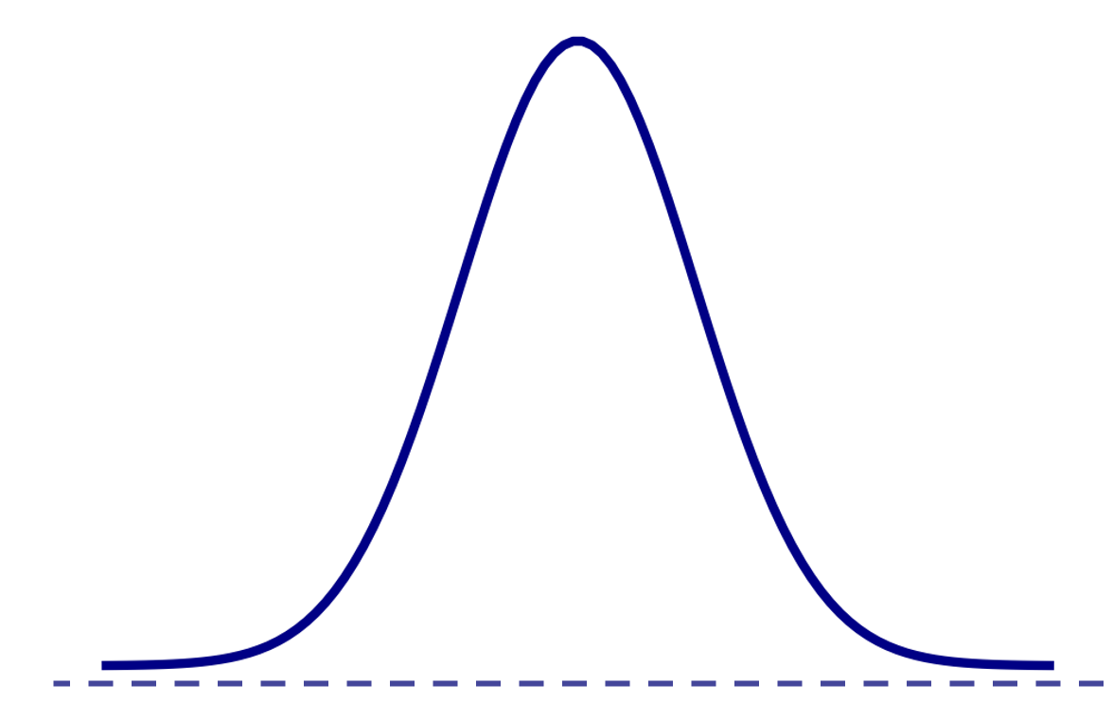

Assumptions
$${SBP}_{i}=β_{0}+β_{1}{Age}_{i}+ε_{i}$$
$$ε_{i}\underset{i.i.d}{∼}{N(0, σ_{ε}) }$$
The relationship between the mean SBP and Age is linear
Observations are independent
SBP|Age is normal (residuals are normally distributed)
And the variance of the residuals is constant (homoscedasticity)
Notes:
The first of which is “simple linear regression”, where we have a continuous outcome, in this case systolic blood pressure, and a continuous covariate in this case age. As this relationship looks fairly linear, or straight, we can describe it with the equation of a line shown. The equation has two parameters beta 0 and beta 1. Beta 0 is the intercept, where the line crosses the y-axis, which here would be interpreted as the mean blood pressure when age equals zero years. Not a particularly useful interpretation, and so we commonly ignore the value of the intercept Beta 0.
Beta 1 on the other hand is the slope, which equals the mean increase in blood pressure for every year increase in age. This interpretation is extremely helpful, as it describes how blood pressure changes with age.

Slide 14
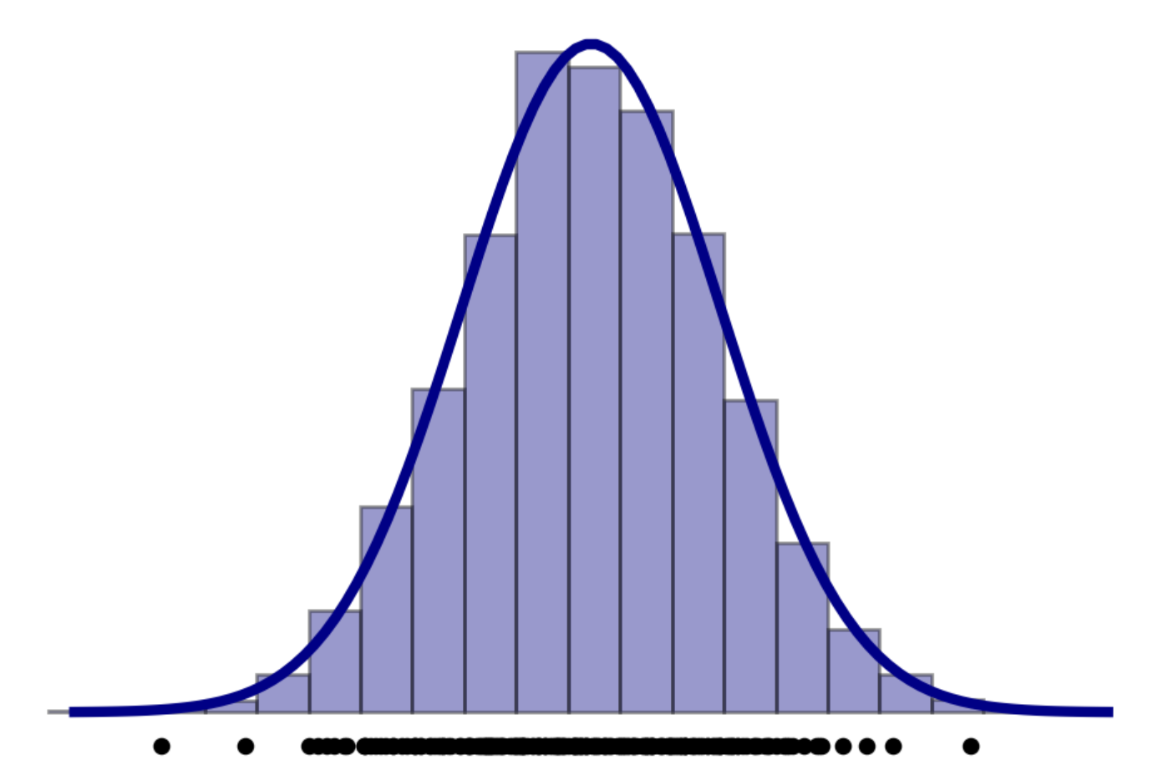

Assumptions
$${SBP}_{i}=β_{0}+β_{1}{Age}_{i}+ε_{i}$$
$$ε_{i}\underset{i.i.d}{∼}{N(0, σ_{ε}) }$$
The relationship between the mean SBP and Age is linear
Observations are independent
SBP|Age is normal (residuals are normally distributed)
And the variance of the residuals is constant (homoscedasticity)
Notes:
The first of which is “simple linear regression”, where we have a continuous outcome, in this case systolic blood pressure, and a continuous covariate in this case age. As this relationship looks fairly linear, or straight, we can describe it with the equation of a line shown. The equation has two parameters beta 0 and beta 1. Beta 0 is the intercept, where the line crosses the y-axis, which here would be interpreted as the mean blood pressure when age equals zero years. Not a particularly useful interpretation, and so we commonly ignore the value of the intercept Beta 0.
Beta 1 on the other hand is the slope, which equals the mean increase in blood pressure for every year increase in age. This interpretation is extremely helpful, as it describes how blood pressure changes with age.

Slide 15
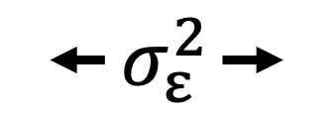
Assumptions
$${SBP}_{i}=β_{0}+β_{1}{Age}_{i}+ε_{i}$$
$$ε_{i}\underset{i.i.d}{∼}{N(0, σ_{ε}) }$$
The relationship between the mean SBP and Age is linear
Observations are independent
SBP|Age is normal (residuals are normally distributed)
And the variance of the residuals is constant (homoscedasticity)
Notes:
The first of which is “simple linear regression”, where we have a continuous outcome, in this case systolic blood pressure, and a continuous covariate in this case age. As this relationship looks fairly linear, or straight, we can describe it with the equation of a line shown. The equation has two parameters beta 0 and beta 1. Beta 0 is the intercept, where the line crosses the y-axis, which here would be interpreted as the mean blood pressure when age equals zero years. Not a particularly useful interpretation, and so we commonly ignore the value of the intercept Beta 0.
Beta 1 on the other hand is the slope, which equals the mean increase in blood pressure for every year increase in age. This interpretation is extremely helpful, as it describes how blood pressure changes with age.

Slide 16
Assumptions
$${SBP}_{i}=β_{0}+β_{1}{Age}_{i}+ε_{i}$$
$$ε_{i}\underset{i.i.d}{∼}{N(0, σ_{ε}) }$$
The relationship between the mean SBP and Age is linear
Observations are independent
The residuals are normally distributed
And the variances of the residuals are the same (homoscedasticity)
Notes:
The first of which is “simple linear regression”, where we have a continuous outcome, in this case systolic blood pressure, and a continuous covariate in this case age. As this relationship looks fairly linear, or straight, we can describe it with the equation of a line shown. The equation has two parameters beta 0 and beta 1. Beta 0 is the intercept, where the line crosses the y-axis, which here would be interpreted as the mean blood pressure when age equals zero years. Not a particularly useful interpretation, and so we commonly ignore the value of the intercept Beta 0.
Beta 1 on the other hand is the slope, which equals the mean increase in blood pressure for every year increase in age. This interpretation is extremely helpful, as it describes how blood pressure changes with age.

Slide 17
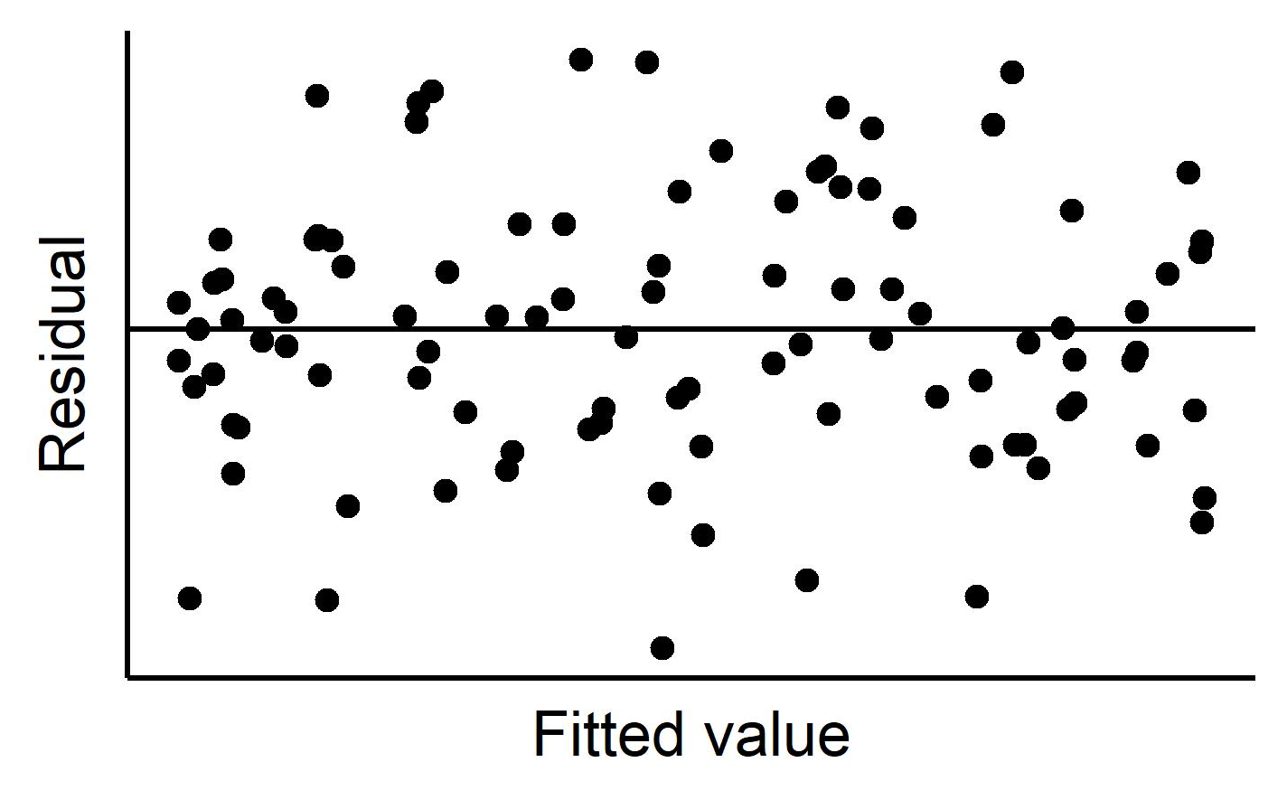

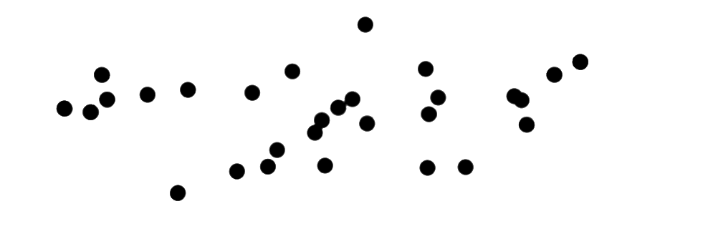
Assumptions
$${SBP}_{i}=β_{0}+β_{1}{Age}_{i}+ε_{i}$$
$$ε_{i}\underset{i.i.d}{∼}{N(0, σ_{ε}) }$$
Notes:
The first of which is “simple linear regression”, where we have a continuous outcome, in this case systolic blood pressure, and a continuous covariate in this case age. As this relationship looks fairly linear, or straight, we can describe it with the equation of a line shown. The equation has two parameters beta 0 and beta 1. Beta 0 is the intercept, where the line crosses the y-axis, which here would be interpreted as the mean blood pressure when age equals zero years. Not a particularly useful interpretation, and so we commonly ignore the value of the intercept Beta 0.
Beta 1 on the other hand is the slope, which equals the mean increase in blood pressure for every year increase in age. This interpretation is extremely helpful, as it describes how blood pressure changes with age.

Slide 18
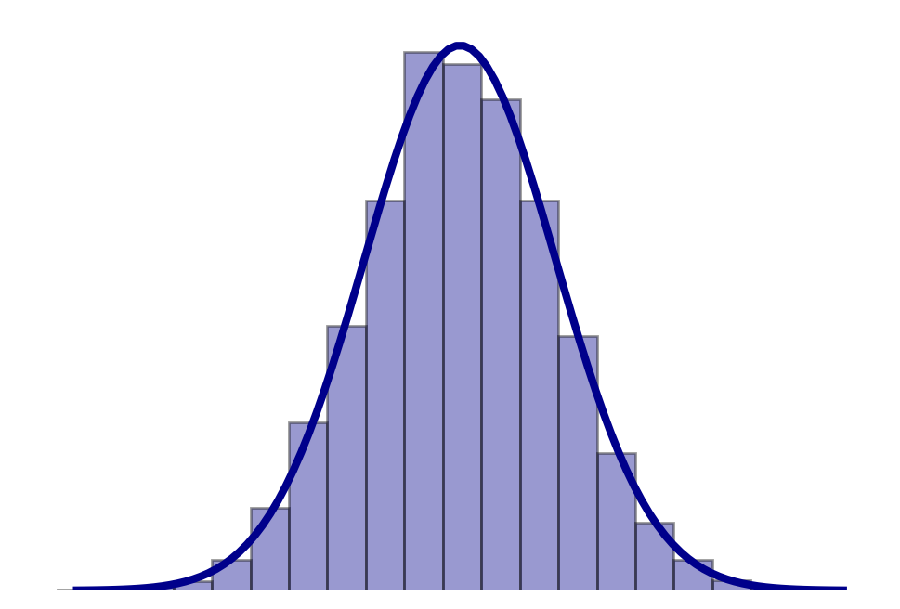
Assumptions
$${SBP}_{i}=β_{0}+β_{1}{Age}_{i}+ε_{i}$$
$$ε_{i}\underset{i.i.d}{∼}{N(0, σ_{ε}) }$$
residuals
Notes:
The first of which is “simple linear regression”, where we have a continuous outcome, in this case systolic blood pressure, and a continuous covariate in this case age. As this relationship looks fairly linear, or straight, we can describe it with the equation of a line shown. The equation has two parameters beta 0 and beta 1. Beta 0 is the intercept, where the line crosses the y-axis, which here would be interpreted as the mean blood pressure when age equals zero years. Not a particularly useful interpretation, and so we commonly ignore the value of the intercept Beta 0.
Beta 1 on the other hand is the slope, which equals the mean increase in blood pressure for every year increase in age. This interpretation is extremely helpful, as it describes how blood pressure changes with age.

Slide 19
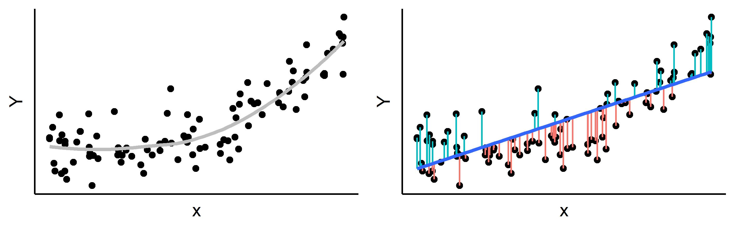
Assumptions
$${SBP}_{i}=β_{0}+β_{1}{Age}_{i}+ε_{i}$$
$$ε_{i}\underset{i.i.d}{∼}{N(0, σ_{ε}) }$$
Notes:
The first of which is “simple linear regression”, where we have a continuous outcome, in this case systolic blood pressure, and a continuous covariate in this case age. As this relationship looks fairly linear, or straight, we can describe it with the equation of a line shown. The equation has two parameters beta 0 and beta 1. Beta 0 is the intercept, where the line crosses the y-axis, which here would be interpreted as the mean blood pressure when age equals zero years. Not a particularly useful interpretation, and so we commonly ignore the value of the intercept Beta 0.
Beta 1 on the other hand is the slope, which equals the mean increase in blood pressure for every year increase in age. This interpretation is extremely helpful, as it describes how blood pressure changes with age.

Slide 20
Assumptions
$${SBP}_{i}=β_{0}+β_{1}{Age}_{i}+ε_{i}$$
$$ε_{i}\underset{i.i.d}{∼}{N(0, σ_{ε}) }$$
Notes:
The first of which is “simple linear regression”, where we have a continuous outcome, in this case systolic blood pressure, and a continuous covariate in this case age. As this relationship looks fairly linear, or straight, we can describe it with the equation of a line shown. The equation has two parameters beta 0 and beta 1. Beta 0 is the intercept, where the line crosses the y-axis, which here would be interpreted as the mean blood pressure when age equals zero years. Not a particularly useful interpretation, and so we commonly ignore the value of the intercept Beta 0.
Beta 1 on the other hand is the slope, which equals the mean increase in blood pressure for every year increase in age. This interpretation is extremely helpful, as it describes how blood pressure changes with age.

Slide 21
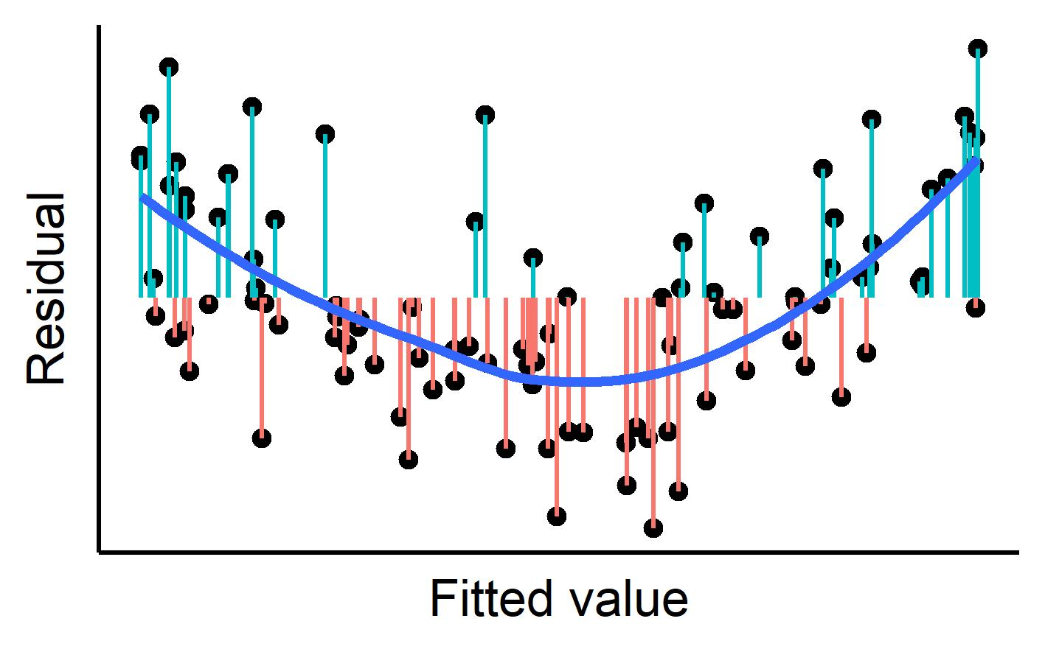
Assumptions
$${SBP}_{i}=β_{0}+β_{1}{Age}_{i}+ε_{i}$$
$$ε_{i}\underset{i.i.d}{∼}{N(0, σ_{ε}) }$$
Notes:
The first of which is “simple linear regression”, where we have a continuous outcome, in this case systolic blood pressure, and a continuous covariate in this case age. As this relationship looks fairly linear, or straight, we can describe it with the equation of a line shown. The equation has two parameters beta 0 and beta 1. Beta 0 is the intercept, where the line crosses the y-axis, which here would be interpreted as the mean blood pressure when age equals zero years. Not a particularly useful interpretation, and so we commonly ignore the value of the intercept Beta 0.
Beta 1 on the other hand is the slope, which equals the mean increase in blood pressure for every year increase in age. This interpretation is extremely helpful, as it describes how blood pressure changes with age.

Slide 22
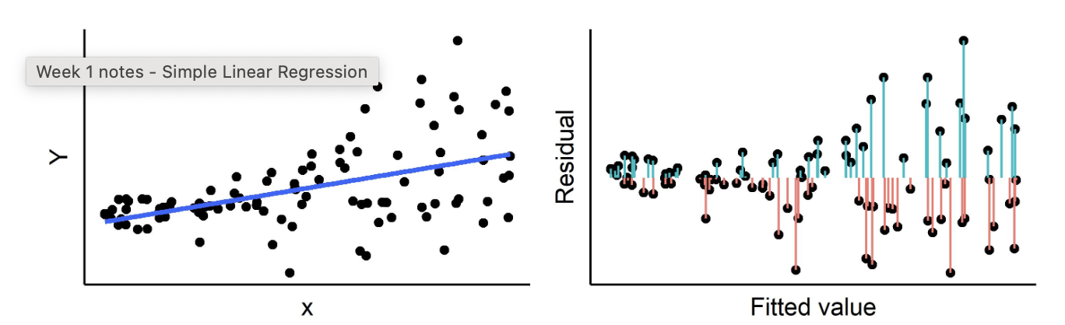
Assumptions
$${SBP}_{i}=β_{0}+β_{1}{Age}_{i}+ε_{i}$$
$$ε_{i}\underset{i.i.d}{∼}{N(0, σ_{ε}) }$$
Notes:
The first of which is “simple linear regression”, where we have a continuous outcome, in this case systolic blood pressure, and a continuous covariate in this case age. As this relationship looks fairly linear, or straight, we can describe it with the equation of a line shown. The equation has two parameters beta 0 and beta 1. Beta 0 is the intercept, where the line crosses the y-axis, which here would be interpreted as the mean blood pressure when age equals zero years. Not a particularly useful interpretation, and so we commonly ignore the value of the intercept Beta 0.
Beta 1 on the other hand is the slope, which equals the mean increase in blood pressure for every year increase in age. This interpretation is extremely helpful, as it describes how blood pressure changes with age.

Slide 23
Assumptions
$${SBP}_{i}=β_{0}+β_{1}{Age}_{i}+ε_{i}$$
$$ε_{i}\underset{i.i.d}{∼}{N(0, σ_{ε}) }$$
Notes:
The first of which is “simple linear regression”, where we have a continuous outcome, in this case systolic blood pressure, and a continuous covariate in this case age. As this relationship looks fairly linear, or straight, we can describe it with the equation of a line shown. The equation has two parameters beta 0 and beta 1. Beta 0 is the intercept, where the line crosses the y-axis, which here would be interpreted as the mean blood pressure when age equals zero years. Not a particularly useful interpretation, and so we commonly ignore the value of the intercept Beta 0.
Beta 1 on the other hand is the slope, which equals the mean increase in blood pressure for every year increase in age. This interpretation is extremely helpful, as it describes how blood pressure changes with age.

Slide 24

Simple linear regression
$$ε_{i}\underset{i.i.d}{∼}{N(0, σ_{ε}) }$$
Observations are independent
The relationship between the mean SBP and Age is linear
The residuals are normally distributed
And the variances of the residuals are the same (homoscedasticity)
Notes:
The first of which is “simple linear regression”, where we have a continuous outcome, in this case systolic blood pressure, and a continuous covariate in this case age. As this relationship looks fairly linear, or straight, we can describe it with the equation of a line shown. The equation has two parameters beta 0 and beta 1. Beta 0 is the intercept, where the line crosses the y-axis, which here would be interpreted as the mean blood pressure when age equals zero years. Not a particularly useful interpretation, and so we commonly ignore the value of the intercept Beta 0.
Beta 1 on the other hand is the slope, which equals the mean increase in blood pressure for every year increase in age. This interpretation is extremely helpful, as it describes how blood pressure changes with age.

Slide 25
Simple linear regression
$$ε_{i}\underset{i.i.d}{∼}{N(0, σ_{ε}) }$$
Observations are independent
The relationship between the mean SBP and Age is linear
The residuals are normally distributed
And the variances of the residuals are the same (homoscedasticity)
Notes:
The first of which is “simple linear regression”, where we have a continuous outcome, in this case systolic blood pressure, and a continuous covariate in this case age. As this relationship looks fairly linear, or straight, we can describe it with the equation of a line shown. The equation has two parameters beta 0 and beta 1. Beta 0 is the intercept, where the line crosses the y-axis, which here would be interpreted as the mean blood pressure when age equals zero years. Not a particularly useful interpretation, and so we commonly ignore the value of the intercept Beta 0.
Beta 1 on the other hand is the slope, which equals the mean increase in blood pressure for every year increase in age. This interpretation is extremely helpful, as it describes how blood pressure changes with age.

Slide 26
Assumptions
$${SBP}_{i}=β_{0}+β_{1}{Age}_{i}+ε_{i}$$
$$ε_{i}\underset{i.i.d}{∼}{N(0, σ_{ε}) }$$
The relationship between the mean SBP and Age is linear
Observations are independent
The residuals are normally distributed
And the variances of the residuals are the same (homoscedasticity)
Notes:
The first of which is “simple linear regression”, where we have a continuous outcome, in this case systolic blood pressure, and a continuous covariate in this case age. As this relationship looks fairly linear, or straight, we can describe it with the equation of a line shown. The equation has two parameters beta 0 and beta 1. Beta 0 is the intercept, where the line crosses the y-axis, which here would be interpreted as the mean blood pressure when age equals zero years. Not a particularly useful interpretation, and so we commonly ignore the value of the intercept Beta 0.
Beta 1 on the other hand is the slope, which equals the mean increase in blood pressure for every year increase in age. This interpretation is extremely helpful, as it describes how blood pressure changes with age.

Slide 27
Assumptions
$${SBP}_{i}=β_{0}+β_{1}{Age}_{i}+ε_{i}$$
$$ε_{i}\underset{i.i.d}{∼}{N(0, σ_{ε}) }$$
The relationship between the mean SBP and Age is linear
Observations are independent
The residuals are normally distributed
And the variances of the residuals are the same (homoscedasticity)
Notes:
The first of which is “simple linear regression”, where we have a continuous outcome, in this case systolic blood pressure, and a continuous covariate in this case age. As this relationship looks fairly linear, or straight, we can describe it with the equation of a line shown. The equation has two parameters beta 0 and beta 1. Beta 0 is the intercept, where the line crosses the y-axis, which here would be interpreted as the mean blood pressure when age equals zero years. Not a particularly useful interpretation, and so we commonly ignore the value of the intercept Beta 0.
Beta 1 on the other hand is the slope, which equals the mean increase in blood pressure for every year increase in age. This interpretation is extremely helpful, as it describes how blood pressure changes with age.

Slide 28
Assumptions
$${SBP}_{i}=β_{0}+β_{1}{Age}_{i}+ε_{i}$$
$$ε_{i}\underset{i.i.d}{∼}{N(0, σ_{ε}) }$$
The relationship between the mean SBP and Age is linear
Observations are independent
The residuals are normally distributed
And the variances of the residuals are the same (homoscedasticity)
Notes:
The first of which is “simple linear regression”, where we have a continuous outcome, in this case systolic blood pressure, and a continuous covariate in this case age. As this relationship looks fairly linear, or straight, we can describe it with the equation of a line shown. The equation has two parameters beta 0 and beta 1. Beta 0 is the intercept, where the line crosses the y-axis, which here would be interpreted as the mean blood pressure when age equals zero years. Not a particularly useful interpretation, and so we commonly ignore the value of the intercept Beta 0.
Beta 1 on the other hand is the slope, which equals the mean increase in blood pressure for every year increase in age. This interpretation is extremely helpful, as it describes how blood pressure changes with age.

Slide 29
Assumptions
$${SBP}_{i}=β_{0}+β_{1}{Age}_{i}+ε_{i}$$
$$ε_{i}\underset{i.i.d}{∼}{N(0, σ_{ε}) }$$
The relationship between the mean SBP and Age is linear
Observations are independent
The residuals are normally distributed
And the variances of the residuals are the same (homoscedasticity)
Notes:
The first of which is “simple linear regression”, where we have a continuous outcome, in this case systolic blood pressure, and a continuous covariate in this case age. As this relationship looks fairly linear, or straight, we can describe it with the equation of a line shown. The equation has two parameters beta 0 and beta 1. Beta 0 is the intercept, where the line crosses the y-axis, which here would be interpreted as the mean blood pressure when age equals zero years. Not a particularly useful interpretation, and so we commonly ignore the value of the intercept Beta 0.
Beta 1 on the other hand is the slope, which equals the mean increase in blood pressure for every year increase in age. This interpretation is extremely helpful, as it describes how blood pressure changes with age.

Slide 30
Simple linear regression
$$ε_{i}\underset{i.i.d}{∼}{N(0, σ_{ε}) }$$
Observations are independent
The relationship between the mean SBP and Age is linear
The residuals are normally distributed
And the variances of the residuals are the same (homoscedasticity)
Notes:
The first of which is “simple linear regression”, where we have a continuous outcome, in this case systolic blood pressure, and a continuous covariate in this case age. As this relationship looks fairly linear, or straight, we can describe it with the equation of a line shown. The equation has two parameters beta 0 and beta 1. Beta 0 is the intercept, where the line crosses the y-axis, which here would be interpreted as the mean blood pressure when age equals zero years. Not a particularly useful interpretation, and so we commonly ignore the value of the intercept Beta 0.
Beta 1 on the other hand is the slope, which equals the mean increase in blood pressure for every year increase in age. This interpretation is extremely helpful, as it describes how blood pressure changes with age.

